Slide 1
EEE 312 Digital Signal Processing Laboratory I
Project Title:
Bangla Number Plate Recognition
Group 05
Hasibul Islam Shovon 1706021
Md Rasel Mia 1706023
Tauhid Shahriar 1706025
Md Abdul Ahad Mamun 1706027
Golam Mahmud Samdani 1706029

Slide 2
Vehicle Bangla Number Plate Recognition: Block Diagrams
Image Acquisition
Plate Region Extraction
Character Segmentation
Match Characters with templates using correlation
Character Recognition
Display the recognized character as a string

Slide 3
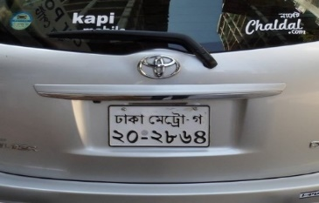
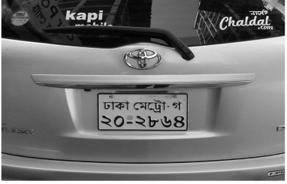
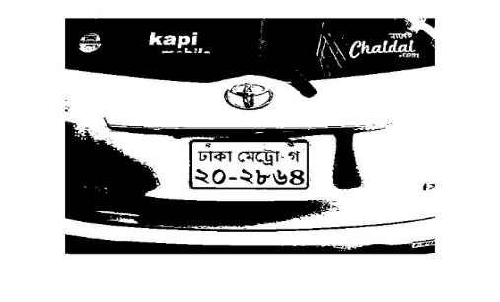

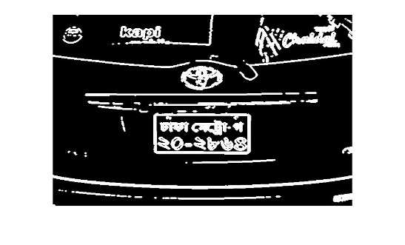
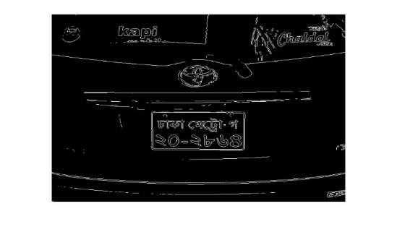

Number Plate Area Extraction
Original Image
Grayscale Image
Binarized Image
Extract Number Plate
Holes Filled
Dilated Image
Detect Edges
Crop the region from the
binarized image using the
extracted position
Extract the position of
the largest rectangle

Slide 4
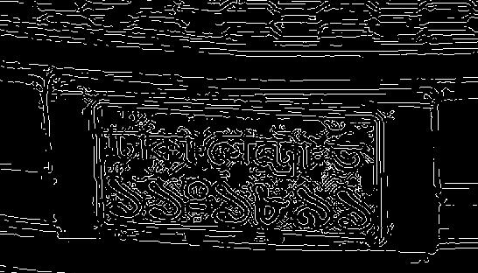
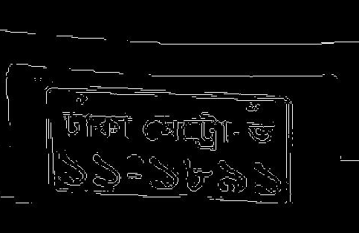
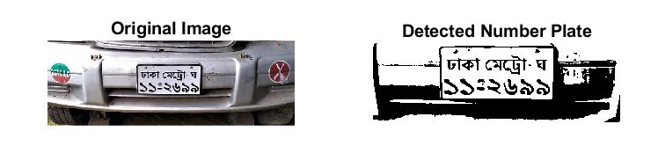
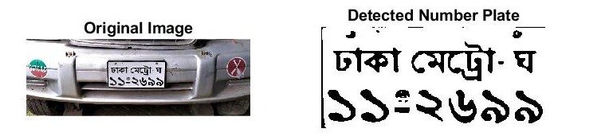
Choosing the Edge Detection Algorithm
Algorithm | No of Cars | Successful Detection
Canny | 30 | 20
LoG | 30 | 23
Sobel | 30 | 29
Prewitt | 30 | 29
Canny Edge Detection
Sobel Edge Detection
Using Canny Edge Detection
Order of sharpness :
Canny > LoG > Sobel > Prewitt >Roberts
Using Sobel Edge Detection

Slide 5
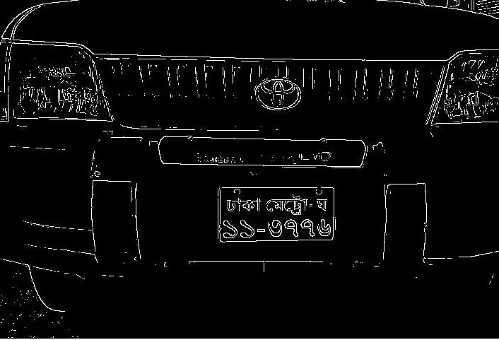
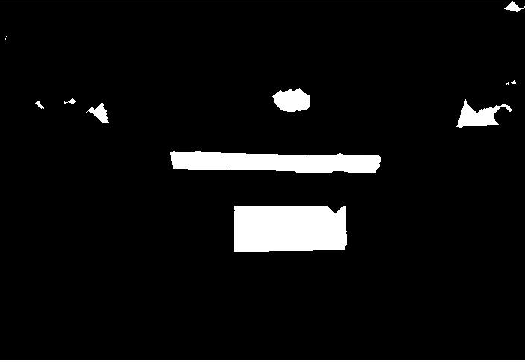
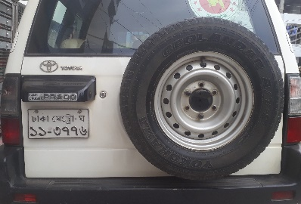
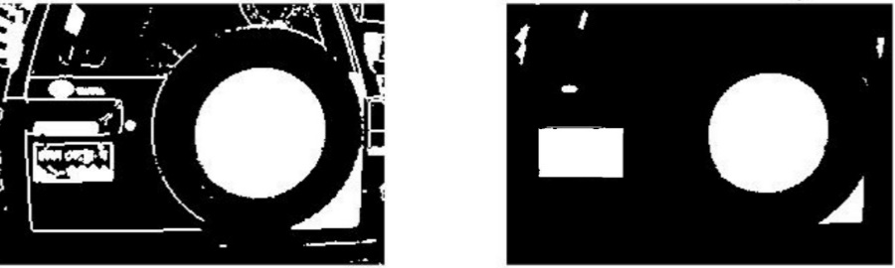
Extracting The Maximum Sized Rectangle
From the filled image we find separate regions. We extract the following information from all the regions:
Ratio of Height and Width
Area
Circularity = 4*pi*Area/(perimeter)^2
Bounding box
Plate Region

Slide 6
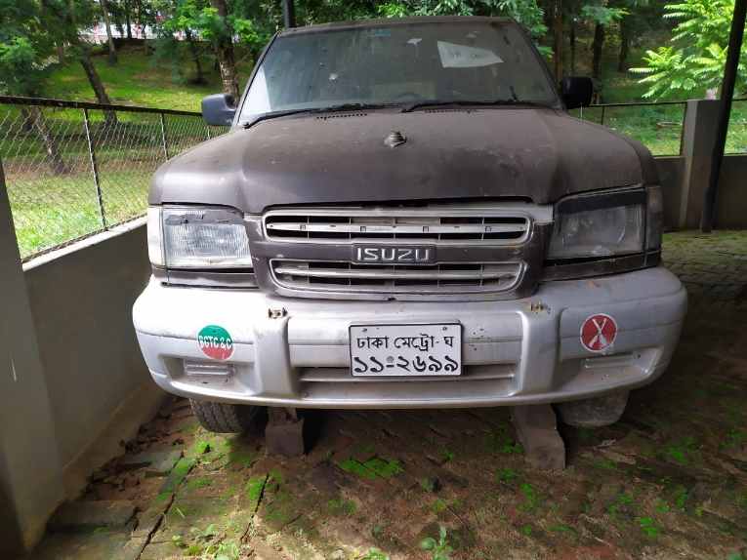
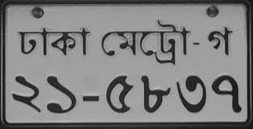
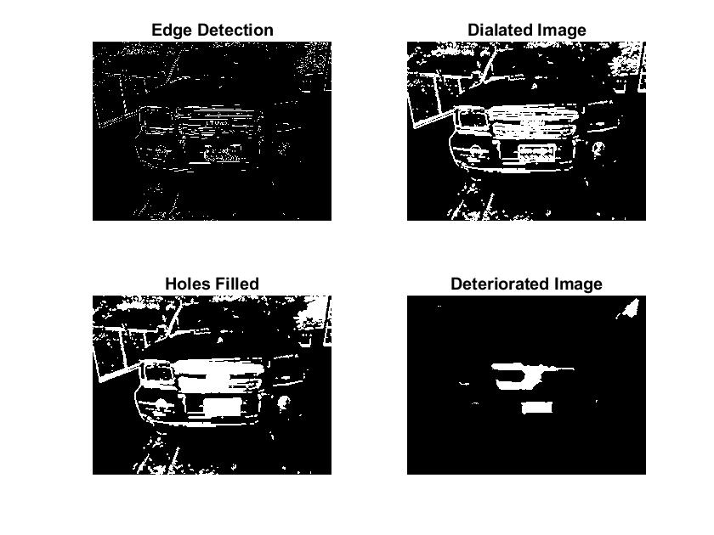
Challenges Faced During Detection
Possible False Detection Region
16 cm
Actual Number Plate
21 cm

Slide 7
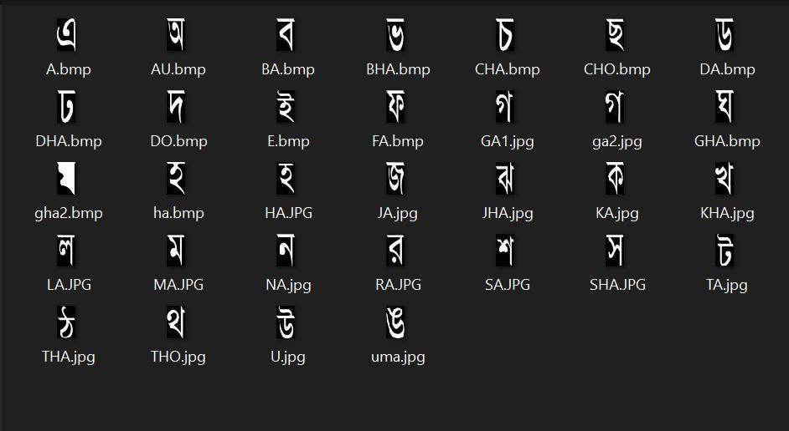
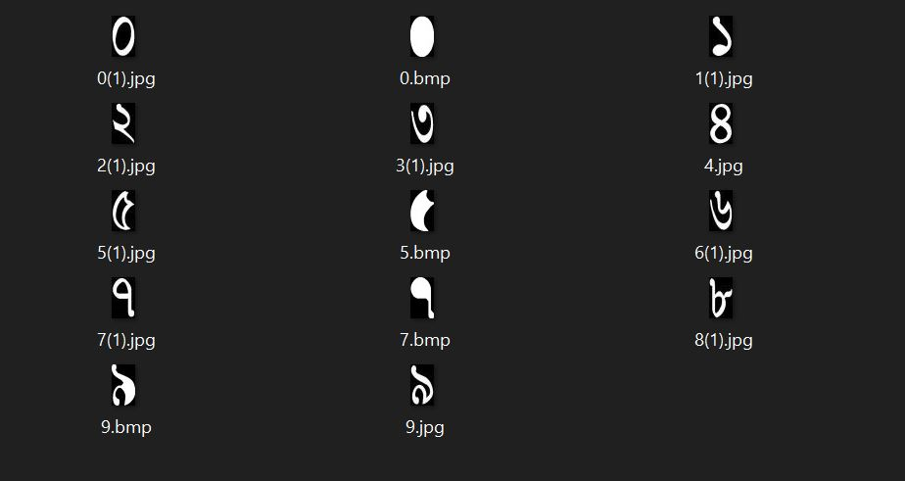
Template Collection
Collection Method
MS Word
Some basic image processing

Slide 8
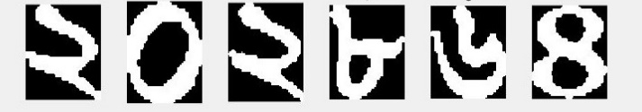
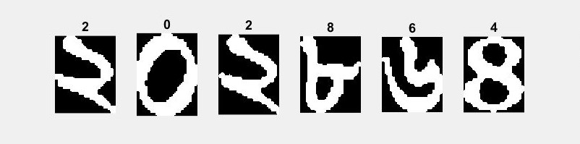
Character Recognition
Match with Templates
Character Segmentation
Number Dataset
Character Recognition

Slide 9
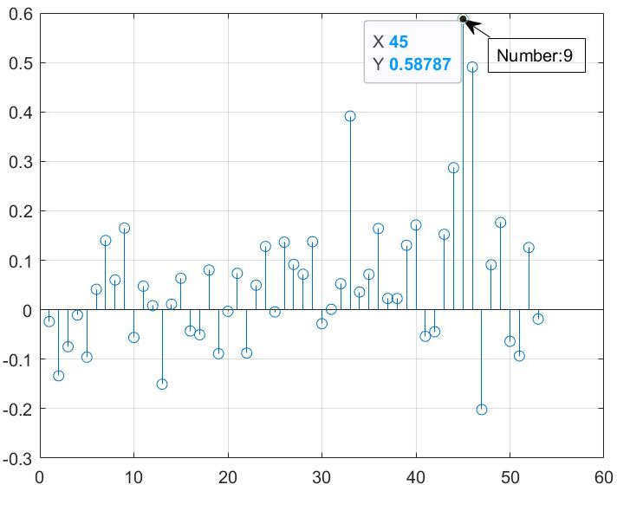
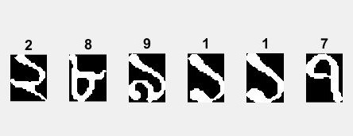
Correlation
From Templates
Extracted Characters From Number Plate
Correlation Between a Segmented Character and All Templates

Slide 10
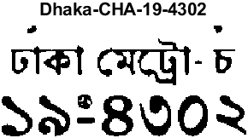
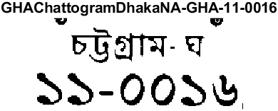
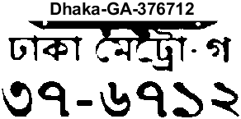
Output
 | No of Samples | Accurate Results | Accuracy
District | 80 | 51 | 63.75%
Character | 80 | 68 | 85%
Number | 480 | 469 | 97.77%

Slide 11
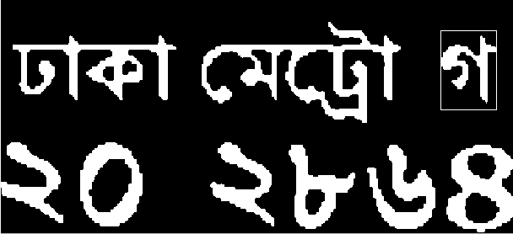
This letter indicates that
the vehicle is a medium sized car

Slide 12
Thank You

